Slide 1



Pizza Sales
Analysis
This presentation explores key insights from pizza sales data using MySQL queries.
by Nivesh kumar
Nk

Slide 2
CONTENTS
Basic:
Intermediate:
Advanced:

Slide 3
Data

Slide 4
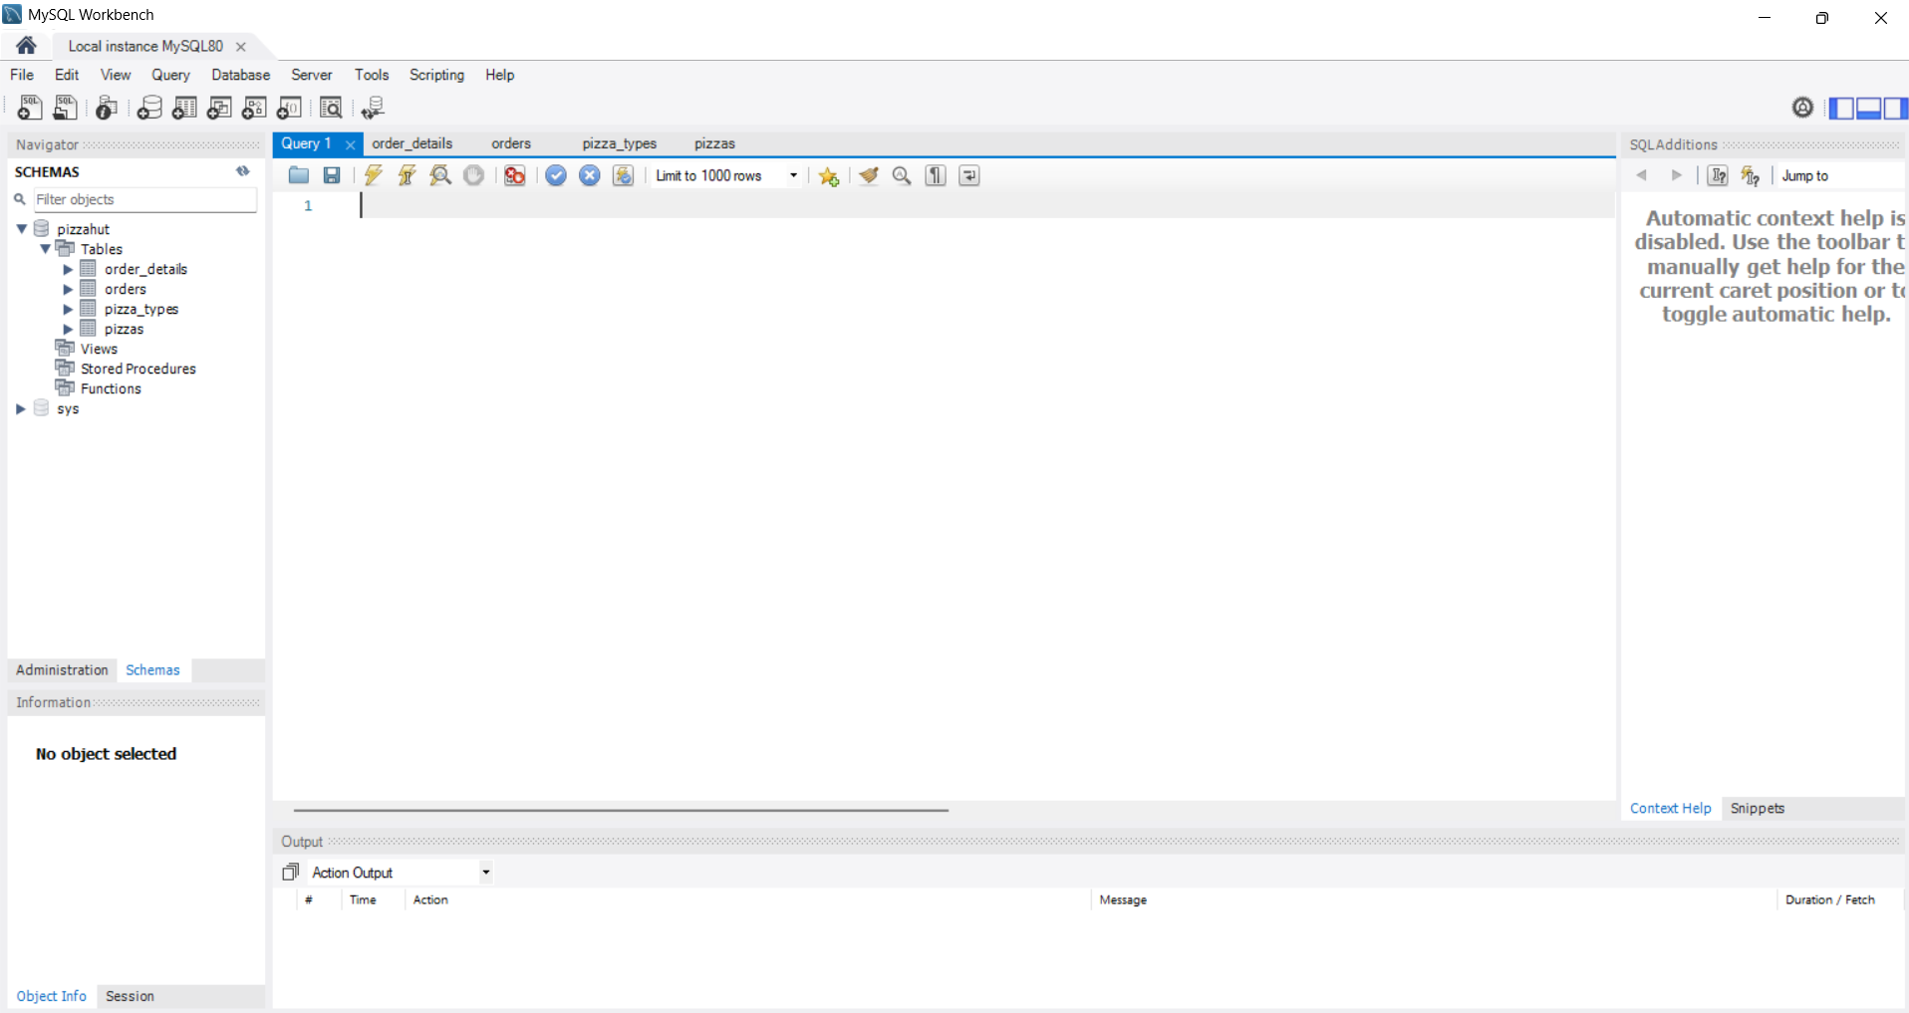

Slide 5
Basic:
Retrieve the total number of orders placed.
Calculate the total revenue generated from pizza sales.
Identify the highest-priced pizza.
Identify the most common pizza size ordered.
List the top 5 most ordered pizza types along with their quantities.

Slide 6
Intermediate:
6. Join the necessary tables to find the total quantity of each pizza
category ordered.
Determine the distribution of orders by hour of the day.
Join relevant tables to find the category-wise distribution of pizzas.
Group the orders by date and calculate the average number of pizzas ordered per day.
Determine the top 3 most ordered pizza types based on revenue.

Slide 7
Advanced:
Calculate the percentage contribution of each pizza type to total
revenue.
Analyse the cumulative revenue generated over time.
Determine the top 3 most ordered pizza types based on revenue for each pizza category.

Slide 8
Retrieve the total number of orders placed.
select count(order_id) as Total_Orders from orders;
2. Calculate the total revenue generated from pizza sales.
SELECT
ROUND(SUM(order_details.quantity * pizzas.price),
2) AS Total_Sales
FROM
order_details
JOIN
pizzas ON pizzas.pizza_id = order_details.pizza_id

Slide 9
3. Identify the highest-priced pizza.
SELECT
pizza_types.name, pizzas.price
FROM
pizza_types
JOIN
pizzas ON pizza_types.pizza_type_id = pizzas.pizza_type_id
ORDER BY pizzas.price DESC
LIMIT 1;

Slide 10
4. Identify the most common pizza size ordered.
SELECT
pizzas.size,
COUNT(order_details.order_details_id) AS Order_Count
FROM
pizzas
JOIN
order_details ON pizzas.pizza_id = order_details.pizza_id
GROUP BY pizzas.size
ORDER BY Order_Count DESC
LIMIT 1;

Slide 11
5. List the top 5 most ordered pizza types along with their quantities.
SELECT
pizza_types.name,
SUM(order_details.quantity) AS Total_Quantity
FROM
pizza_types
JOIN
pizzas ON pizza_types.pizza_type_id = pizzas.pizza_type_id
JOIN
order_details ON order_details.pizza_id = pizzas.pizza_id
GROUP BY pizza_types.name
ORDER BY Total_Quantity DESC
LIMIT 5;

Slide 12
6. Join the necessary tables to find the total quantity of each pizza category ordered.
SELECT
pizza_types.category,
SUM(order_details.quantity) AS Total_quantity
FROM
pizza_types
JOIN
pizzas ON pizza_types.pizza_type_id = pizzas.pizza_type_id
JOIN
order_details ON order_details.pizza_id = pizzas.pizza_id
GROUP BY pizza_types.category;

Slide 13
Determine the distribution of orders by hour of the day.
SELECT
hour(time) AS order_hour, COUNT(order_id) AS order_count
FROM
orders
GROUP BY order_hour
ORDER BY order_hour;

Slide 14
8. Join relevant tables to find the category-wise distribution of pizzas.
SELECT
pizza_types.category, COUNT(pizza_types.name) AS name_count
FROM
pizza_types
GROUP BY pizza_types.category;

Slide 15
9. Group the orders by date and calculate the average number of pizzas ordered per day.
SELECT
ROUND(AVG(quantity), 0)
FROM
(SELECT
orders.date, SUM(order_details.quantity) AS quantity
FROM
orders
JOIN order_details ON orders.order_id = order_details.order_id
GROUP BY orders.date) AS order_quantity

Slide 16
10. Determine the top 3 most ordered pizza types based on revenue.
SELECT
pizza_types.name,
SUM(pizzas.price * order_details.quantity) AS revenue
FROM
pizza_types
JOIN
pizzas ON pizza_types.pizza_type_id = pizzas.pizza_type_id
JOIN
order_details ON order_details.pizza_id = pizzas.pizza_id
GROUP BY pizza_types.name
ORDER BY revenue DESC
LIMIT 3;

Slide 17
Calculate the percentage contribution of each pizza type to total revenue.
select date
date,
SUM(revenue) OVER (ORDER BY date) AS cum_revenue
from
(select orders.date,
sum(pizzas.price*order_details.quantity) as revenue
from orders join order_details
on orders.order_id = order_details.order_id
join pizzas
on pizzas.pizza_id = order_details.pizza_id
group by orders.date) as sales;

Slide 18
Analyse the cumulative revenue generated over time.
select date
date,
SUM(revenue) OVER (ORDER BY date) AS cum_revenue
from
(select orders.date,
sum(pizzas.price*order_details.quantity) as revenue
from orders join order_details
on orders.order_id = order_details.order_id
join pizzas
on pizzas.pizza_id = order_details.pizza_id
group by orders.date) as sales;

Slide 19
13. Determine the top 3 most ordered pizza types based on revenue for each pizza category.
SELECT name, revenue
FROM (
SELECT
pizza_types.category,
pizza_types.name,
round(SUM(order_details.quantity * pizzas.price),0) AS revenue,
RANK() OVER (PARTITION BY pizza_types.category ORDER BY SUM(order_details.quantity * pizzas.price) DESC) AS ranks
FROM
pizza_types
JOIN
pizzas ON pizza_types.pizza_type_id = pizzas.pizza_type_id
JOIN
order_details ON pizzas.pizza_id = order_details.pizza_id
GROUP BY
pizza_types.category,
pizza_types.name
) AS niv
WHERE ranks <= 3;

Slide 20
THANK YOU

